Slide 1


Customer Churn Analysis
An Explanation

Slide 2


What is Customer Churn?
Customer churn is the percentage of customers that stopped using your company's product or service during a certain time frame.

Slide 3
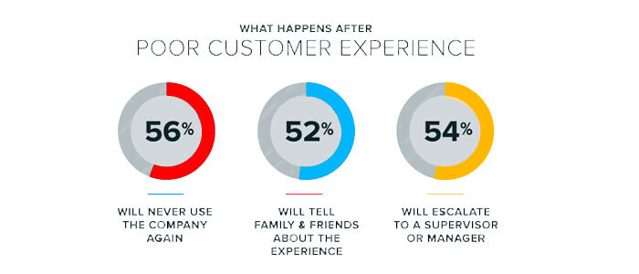
Causes of Churning
Poor customer services provided by the company.
Lack of value.
Lack of brand loyalty.

Slide 4
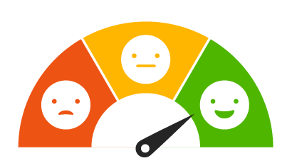
Benefits of Preventing Customer Churning
Gain information for improvement.
Reduce the risk of business failure.
Understand the target Market.
Build a competitive advantage in the market.

Slide 5
Why do we need to predict Customer Churn?
Customer churn can have a significant impact on a business's revenue and profitability, as lost customers represent lost revenue.
By predicting which customers are at risk of leaving, a business can take steps to retain them.
Cost saving as retaining existing customers is typically less expensive than acquiring new ones.

Slide 6
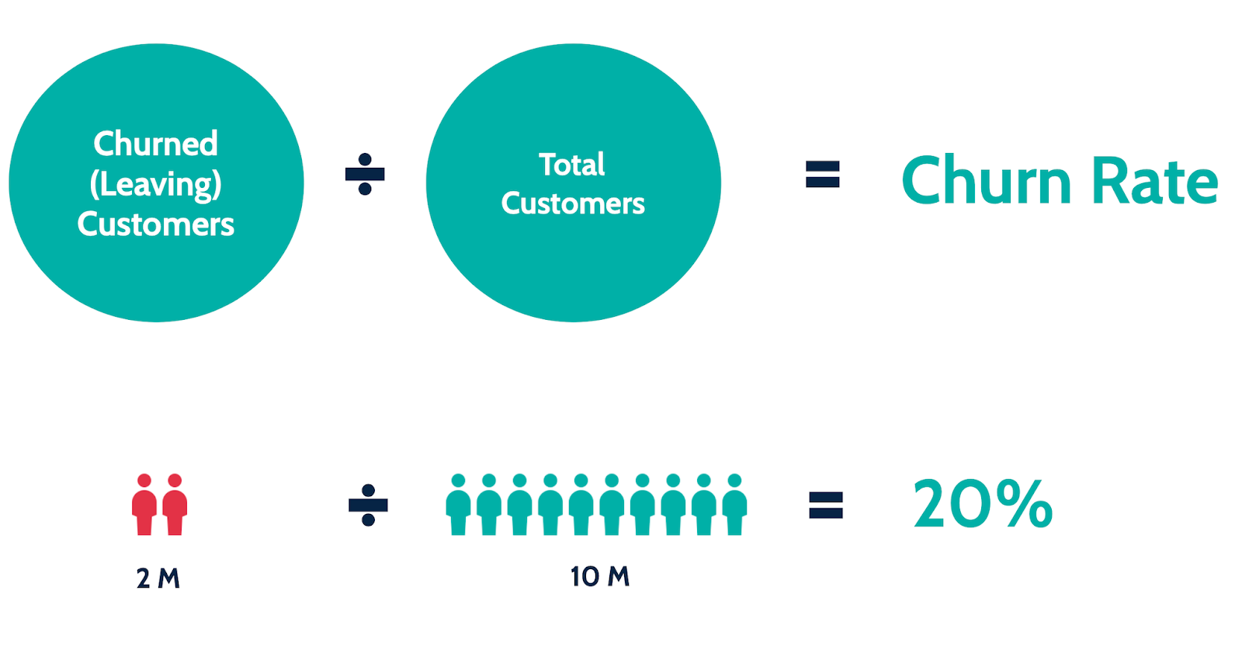
Example
If you start your quarter with 400 customers and end with 380, your churn rate is 5% because you lost 5% of your customers.

Slide 7
Conclusion
Customer churn is now the biggest nightmare that most businesses face.
The customer churn metrics are a good way of estimating how many customers are abandoning your business and how much lost revenue you are suffering as an effect.
With the help of these metrics we can retain our customers.

